Slide 1

#AvatarXPRIZE

Slide 2
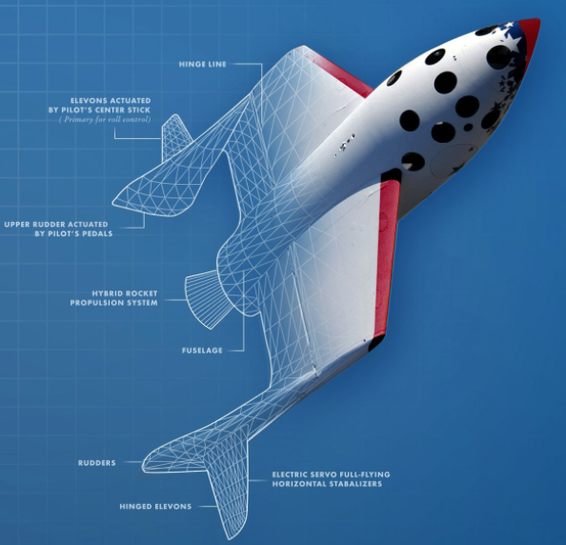
What is Xprize?
XPRIZE IS THE WORLD’S LEADING PRIZE ORGANIZATION CREATING GLOBAL COMPETITIONS TO SOLVE THE GRAND CHALLENGES OF OUR TIME.
AN XPRIZE IS A HIGHLY LEVERAGED, INCENTIVIZED PRIZE COMPETITION THAT PUSHES THE LIMITS OF WHAT’S POSSIBLE TO CHANGE THE WORLD FOR THE BETTER.
Notes:
XPRIZE IS THE WORLD’S LEADING PRIZE ORGANIZATION CREATING GLOBAL COMPETITIONS which aim TO SOLVE THE GRAND CHALLENGES OF OUR TIME.
WE have been running incentive prize competitions for the last 20 years (starting with the Ansari XPRIZE) and have conducted prizes in a number of different verticals including, space exploration, education, ocean health, safety, environment etc..
We have awarded in excess of 30 million dollars to date across our various prize endeavors and we look forward to adding the Avatar XPRIZE to our list of successful prizes.

Slide 3
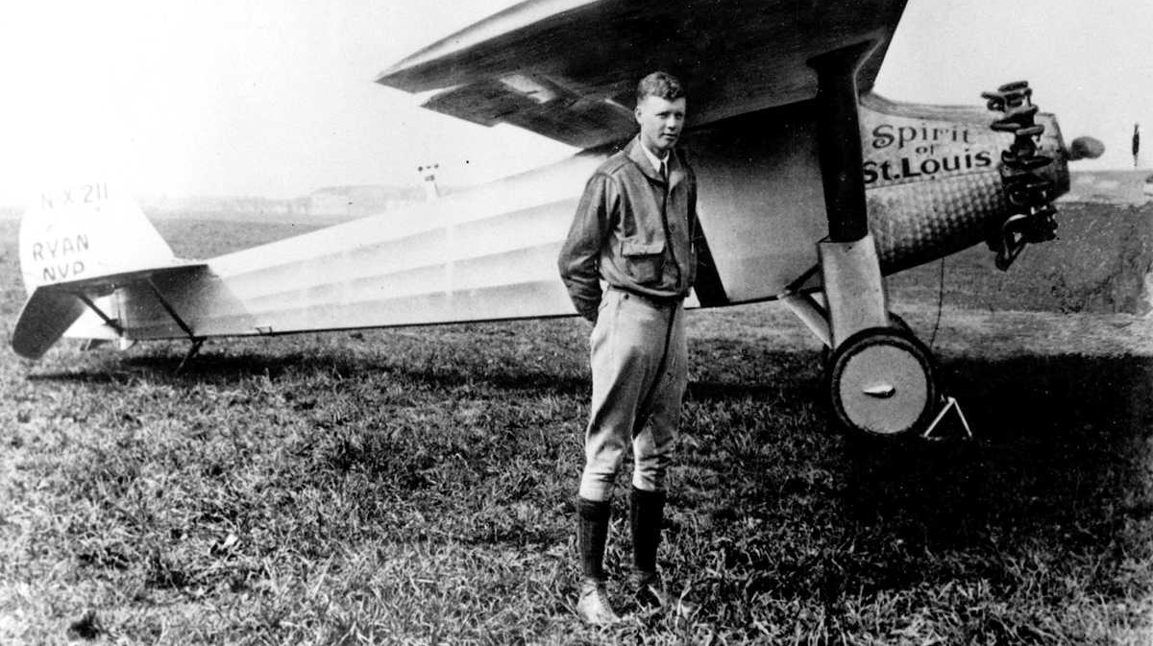
Prize Origins…
… A prize of $25,000 to the first solo aviator to cross the Atlantic in one flight, from Paris to NY or NY to Paris. - Raymond Orteig
1919
Notes:
Raymond Orteig Prize inspired the creation of XPRIZE
Hotel magnate Raymond Orteig offered the $25,000 Prize for the first person to fly non-stop between New York and Paris.
Prize had nine different attempts to cross the Atlantic, which cost a cumulative $400,000 to win the $25,000 purse.
Six people died in attempts
In 1927, 25-year-old underdog Charles Lindbergh won the prize.
No experience: 3 year air mail pilot, Flying fool
No money: Used all his savings
No history/materials: Developed a single engine plane
Nothing for granted: Trimmed edges of his maps, threw out all safety gear
Developed a new model for dead reckoning by air

Slide 4
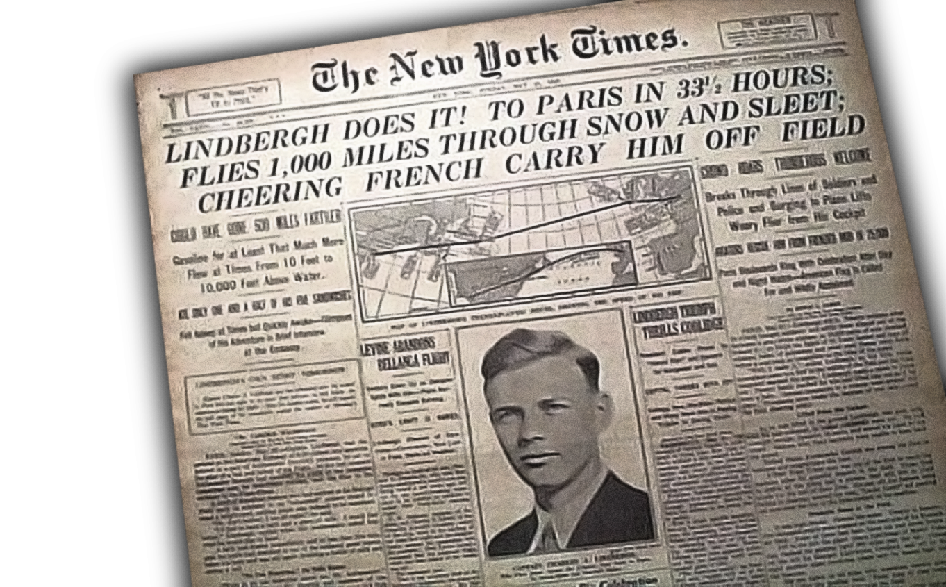
Commercial aviation was born
Notes:
…Spawned today’s $300 billion aviation industry and changed the paradigm of air travel and distance forever.
PRIZES CHANGE WHAT PEOPLE THINK IS POSSIBLE
Within 3 years:
# of passengers went up by 30x in 3 year
300% increase in apps for pilots licenses in 1 year
400% increase in licensed aircraft in 1 year
30M Americans saw Spirit of St. Louis in 1 year after the flight
The story of Charles Lindbergh illustrates the inspiration for the XPRIZE---Spirit of St. Louis, Peter Diamandis

Slide 5
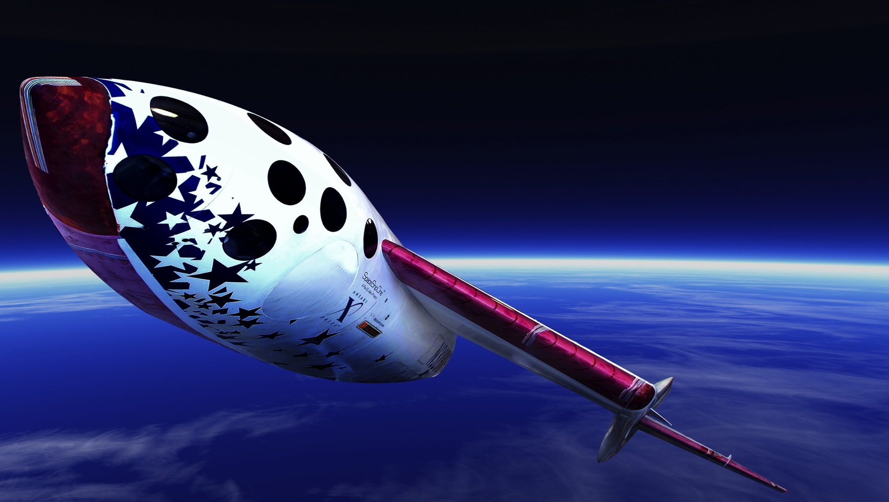
Fly 100 km altitude
Twice in 2 weeks
3 person crew
Privately funded
$10 Million purse
Launched commercial space industry
2004
Notes:
With the Spirit of St. Louis in mind, and a lifelong dream to go into space, but knowing only governments were doing this, CEO Peter Diamandis created the Ansari XPRIZE
$10M price for the first team to fly into space – twice in 2 weeks.
This launched the commercial space agency …

Slide 6


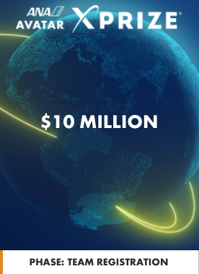
The NEXT
XPRIZE
Notes:
To date the XPRIZE has awarded over $30M dollars for breakthroughs in fields including: fuel-efficient vehicles, ocean health, safety, water, etc.

Slide 7
Ana avatar XPRIZE
The $10M ANA Avatar XPRIZE is a four-year global competition focused on the development of a robotic Avatar System that will transport an operator’s senses, actions, and presence to a remote location in real time, leading to a more connected world.
Notes:
ANA and XPRIZE realize that our ability to physically experience another geographic location, or to provide on-the-ground assistance where needed, is limited by cost and time. It’s time for a disruption.
READ OFF SLIDE
The ANA Avatar XPRIZE can bypass these limitations, allowing us to more rapidly and efficiently distribute skills and hands-on expertise to distant geographic locations where they are needed, transcending the barriers of distance and time.

Slide 8
HOW TO WIN
The winning team will integrate multiple emerging technologies to develop a physical, non-autonomous robotic Avatar System with which an operator can see, hear, and interact within a remote environment in a manner that feels as if they are truly there.
Notes:
READ SLIDE
A successful solution to this challenge will enable humankind to take the next step in transcending the limits of physical transportation, leading to a more connected world.
This sense of presence in a physical embodied Avatar form is a key principle by which the overall success of the winning Avatar System will be evaluated.

Slide 9
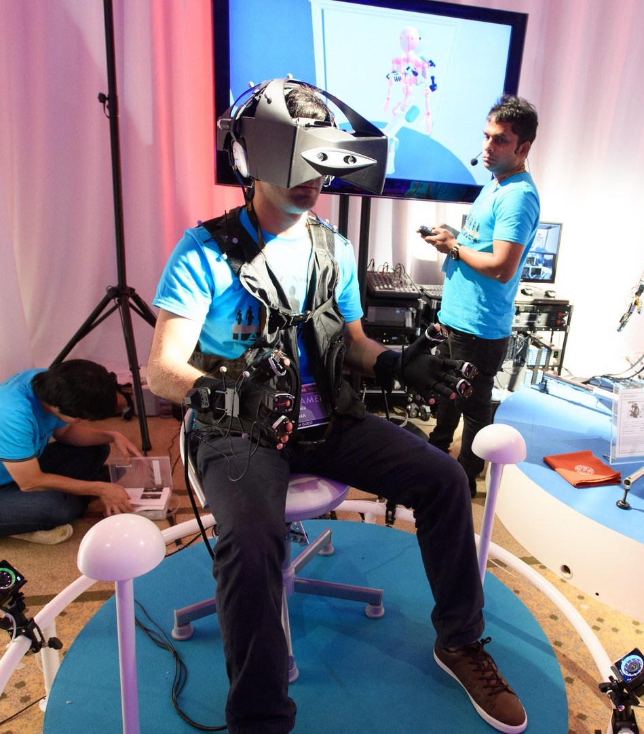
defining AVATAR
Avatar System (n): A physical Robotic Avatar operated by a person which enables the operator to interact within a remote environment in real time
Notes:
A complete avatar system integrates multiple exponential technologies, including robotics, machine learning / artificial intelligence (AI), advanced sensors, brain machine interface (BMI), Internet of Things (IoT), and virtual and augmented reality (VR and AR), to leverage human skills and experience

Slide 10
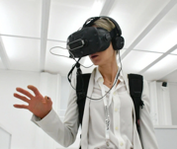
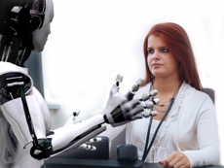

Avatars, connect humans to humans, or humans to a need.
Notes:
This slide and the next outline the core goals of this competition.
- To change the way humans connect with one another, and enable better capabilities and stronger experiences through enhanced connectivity

Slide 11
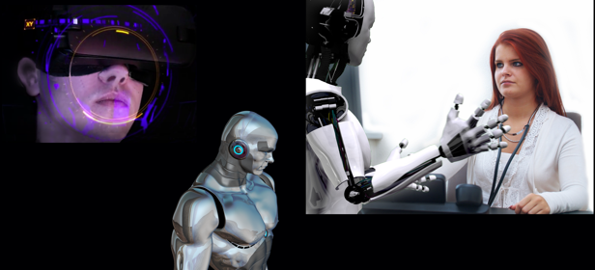
We feel as if we are truly present in that Avatar.
Others feel as if we are truly present in that Avatar.
Notes:
A very interesting component of this competition is “felt presence”, highly researched and presents a challenge to experts.
Extending our humanness across large distances without physically travelling there.

Slide 12
Prize Video
https://xprizefoundation.app.box.com/file/302082443391
Notes:
Use this video link if file does not play

Slide 13
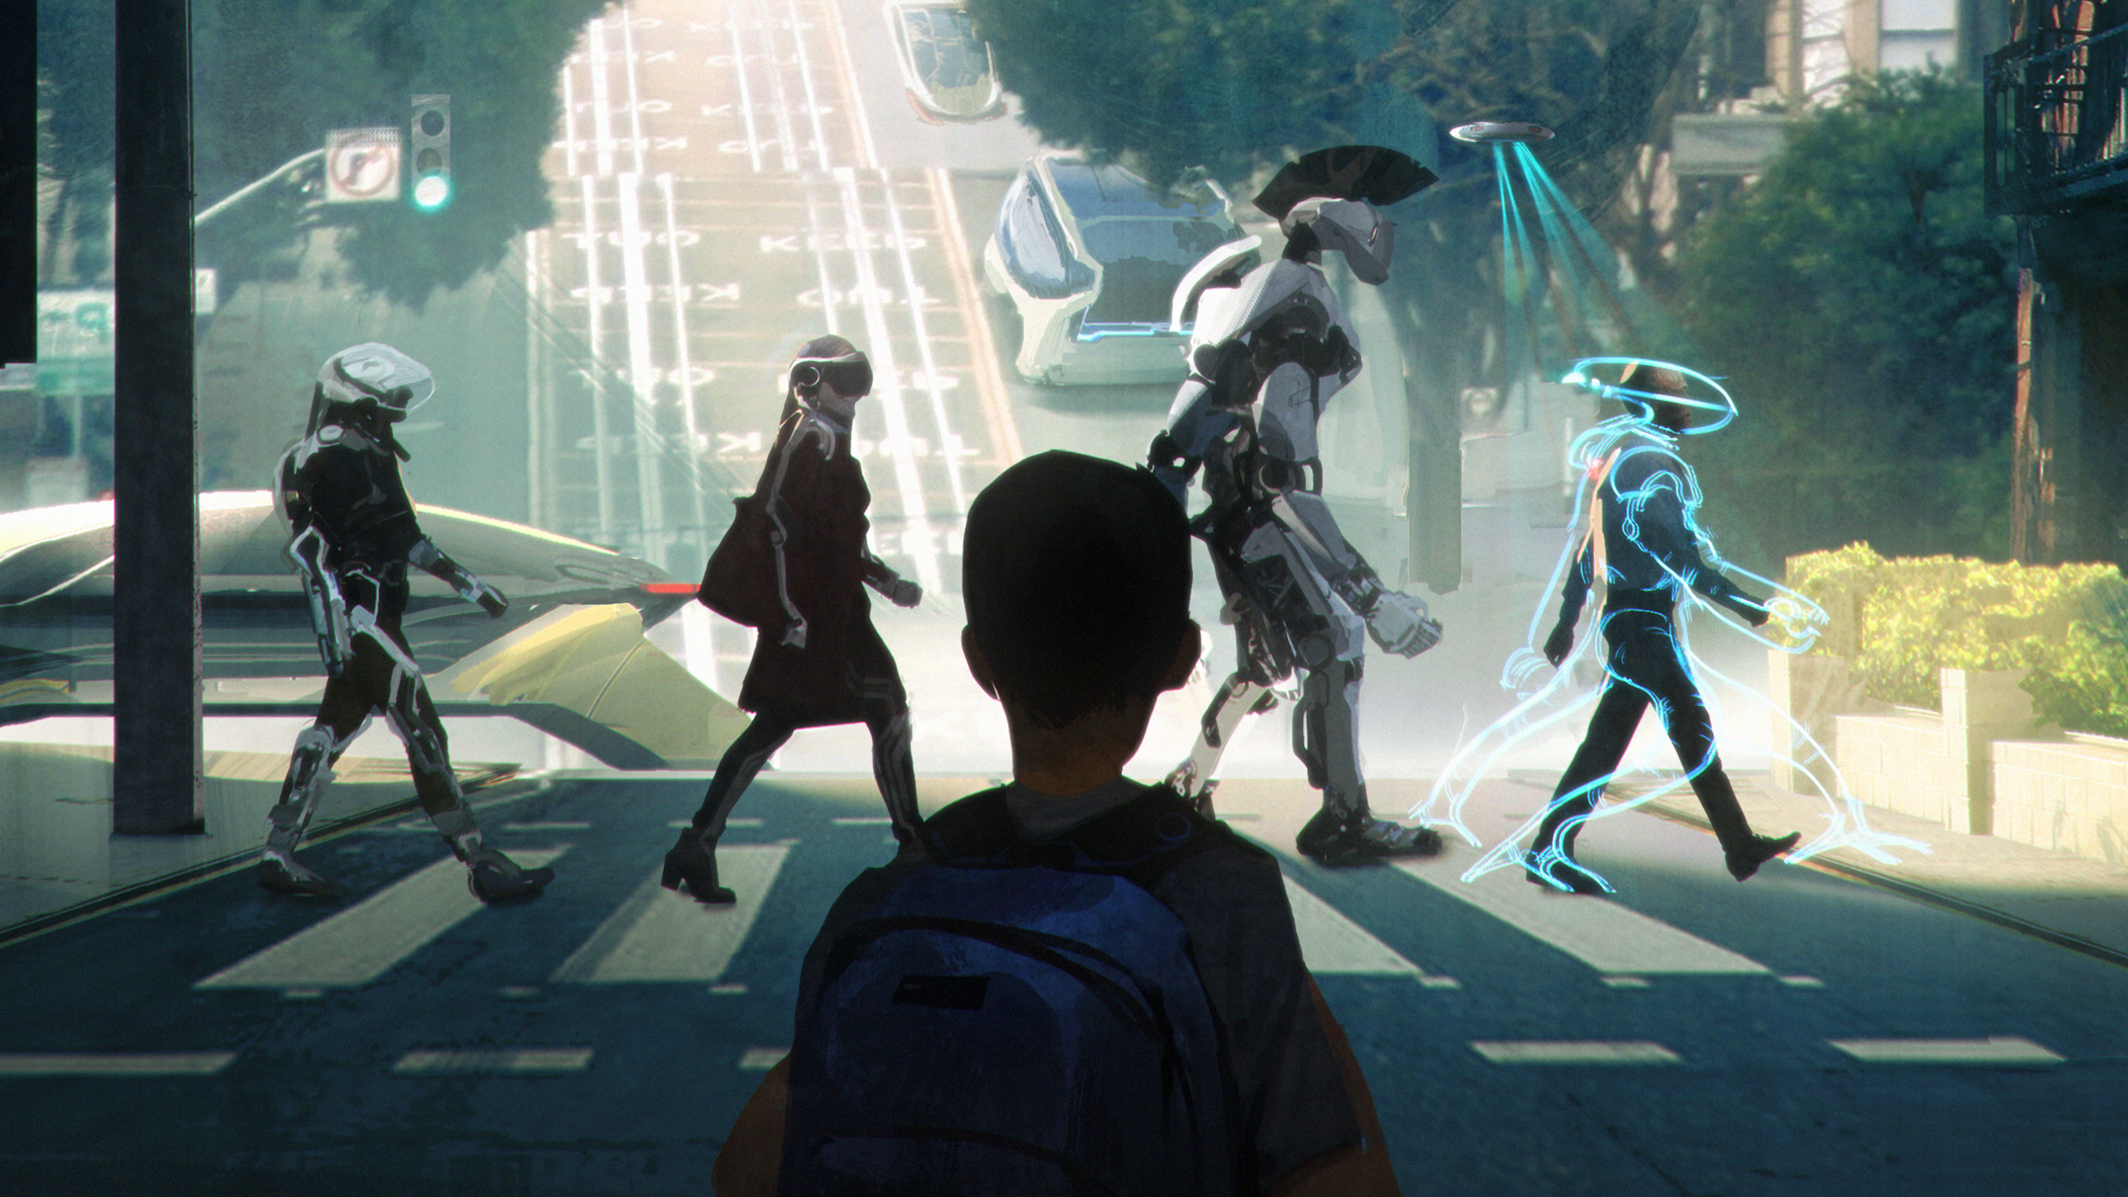
Many overlapping technologies
VR/AR | Motion Capture | Telepresence | Eye Tracking |
5G NETWORKING | Navigation | Cognitive Mapping
| Simultaneous Localization and Mapping | 4D EFFECTS
| Tracking Systems | Brain-Computer Interfaces
Artificial intelligence | Spatial Audio |
Haptic Devices | Computer Vision
Notes:
DL talk about how as you travel going to conferences etc. what you are seeing today is use of these technologies in a VIRTUAL world. There is nothing making this sense of presence in the REAL WORLD.
COLLABORATION:
Winning this XPRIZE will require a collaborative approach between diverse teams across many fields of technology and engineering. We encourage teams to connect with one another to discuss potential mergers and to drive team building for this competition.

Slide 14
Avatar uses
Imagine the following scenarios…
Notes:
In countries like China, the elderly population largely outnumbers the younger population capable of caring for them.
People have to uproot their lives in order to take care of their aging parents or family members.
Avatars would help by allowing people to assist the elderly without needing to be physically present.
DL ADD NOTES HERE FROM PREVIOUS WORKSHOP SESSIONS

Slide 15

PROVIDING CARE
Avatars could give loved ones the experience of your presence and care even when you’re far away.
Notes:
In countries like China, the elderly population largely outnumbers the younger population capable of caring for them.
People have to uproot their lives in order to take care of their aging parents or family members.
Avatars would help by allowing people to assist the elderly without needing to be physically present.

Slide 16
DISASTER RELIEF
Avatars could transport critical life-saving skills in real-time to remote, disaster-struck areas where it is too dangerous for humans.

Slide 17
MULTIPURPOSE UTILITY
Experts can utilize avatars to provide unique services or rare trade skills for critical maintenance or repairs.
Notes:
Examples of uses: electricians, plumbers, specialized medical response, skilled exploration of remote places

Slide 18
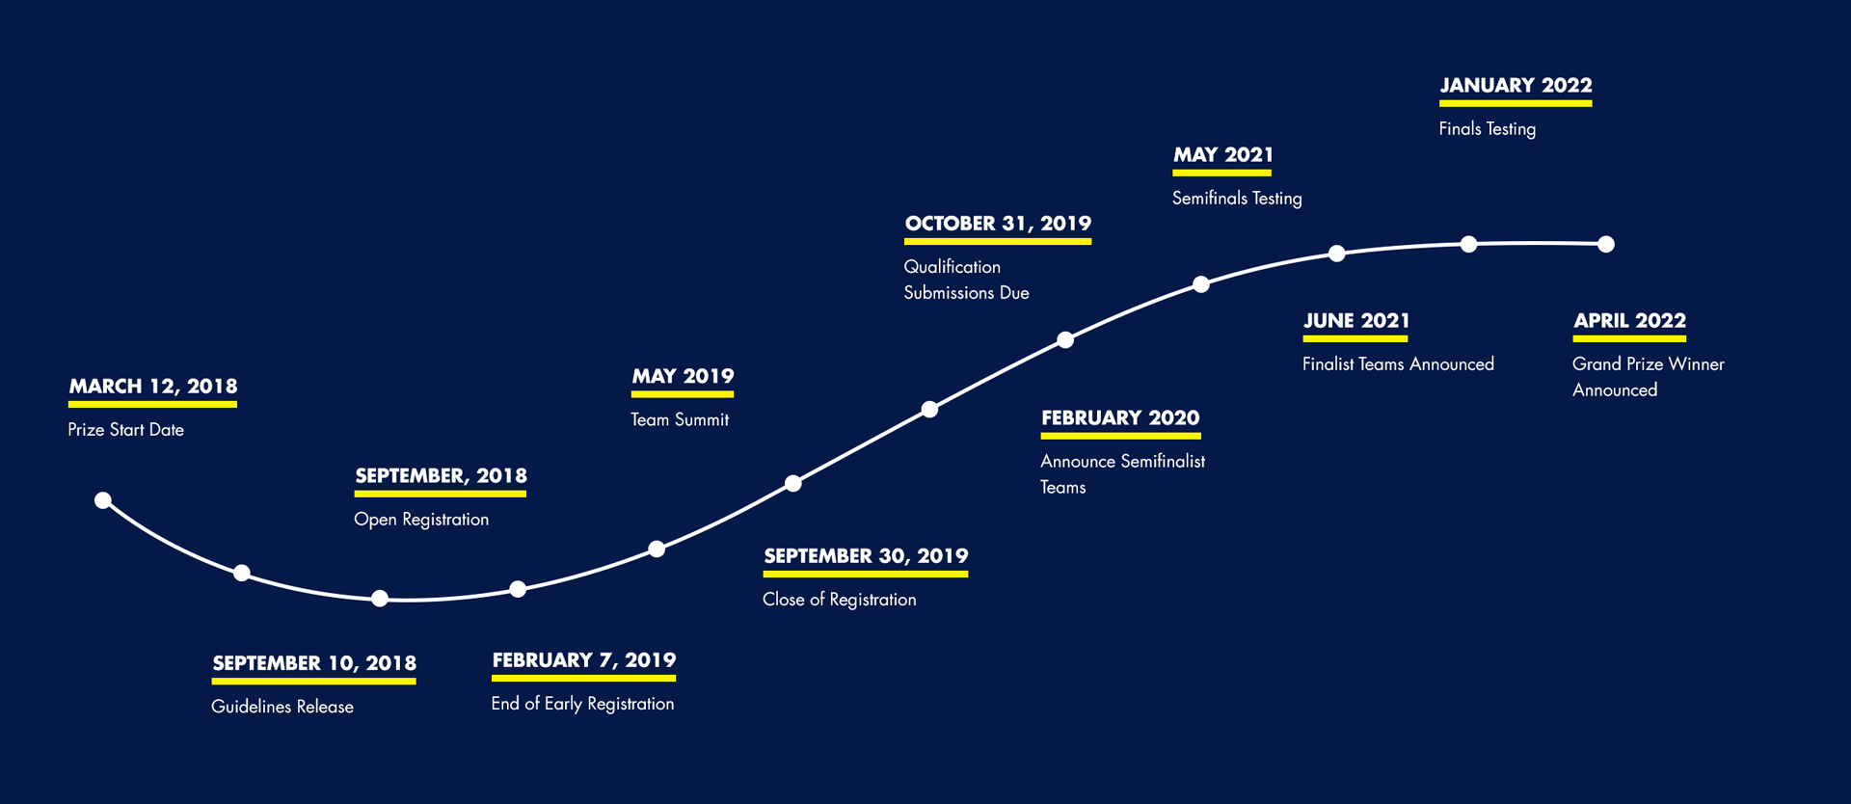

Competition TIMELINE
EVENTS AND DATES ARE TENTATIVE AND SUBJECT TO CHANGE
Notes:
DAVID
Here is a quick overview of current prize timeline, and I’ll go into more details on each of these activities in just a moment, but I first wanted to note where we are in the process….
We’ve just closed early team registration and…

Slide 19
Avatar XPRIZE Early-registered teams
69 Early-Registered Teams from 18 Countries
Country | # Teams | Country | # Teams
Australia | 3 | Japan | 10
Brazil | 1 | Jordan | 1
Canada | 4 | Mexico | 1
Colombia | 1 | Netherlands | 2
Czech Republic | 1 | Russia | 2
Finland | 1 | Switzerland | 3
Germany | 2 | United Kingdom | 3
India | 3 | United States | 29
Italy | 1 | Vietnam | 1
Notes:
After nearly a year since we launched the Avatar XPRIZE at SXSW, we now have a diverse selection of teams from across the world
As of the close of registration on January 31 we have recruited nearly 70 teams from 18 countries.
Registration will continue through September 31 2019

Slide 20
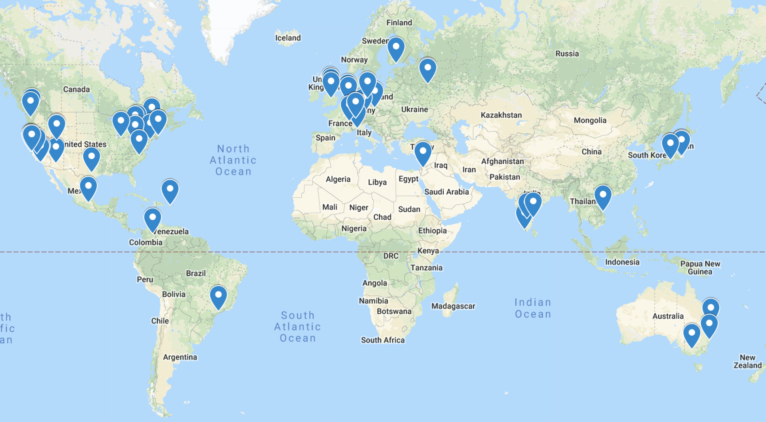
ANA Avatar XPRIZE Teams – Global Distribution

Slide 21
Public Feedback Use Cases
Use Avatar technology for handicapped individuals to live in alternate spaces where they have full motion capabilities.
Can use avatars for multi-tasking. Instead of having to run multiple errands etc. could potentially run multiple errands etc. from our home using Avatars.
Maybe the Avatar can assist you in the task you are looking to do. Can use this to surpass YOUTUBE instructions videos.
“Hands/skills on demand”...if you have an avatar at home you can essentially hire an operator to beam in and conduct whatever job you need done or completed.
Notes:
As we continue to decvelop and co

Slide 22
Creative Exercise
Imagine living in a future where avatars are abundant…
Who will be using them?
What will they be capable of?
How will they make the world better?
Notes:
Use this as a thought provoking exercise during the presentation. If able, we can actually engage the crowd to get a few ideas from them

Slide 23
avatar@XPRIZE.org
Avatars will change how humanity connects
Join the conversation at #AvatarAnywhere
Notes:
THANK YOU for joining us today! We will post this recording and presentation slides to POP for your review later.
Please reach out to us with more questions related to POP, or the competition in general, at avatar@XPRIZE.org. We’re here to help you.
Sign off

